Slide 1

Eapp personas
Paul Laudun

Slide 2

Persona 1
“Hi, we are an old family that lives out in a remote part of the country. We are too occupied by our farm and we aren’t all too tech savvy. We are concerned about not having Healthcare and we need a simple, easy, way to enroll.”

Slide 3
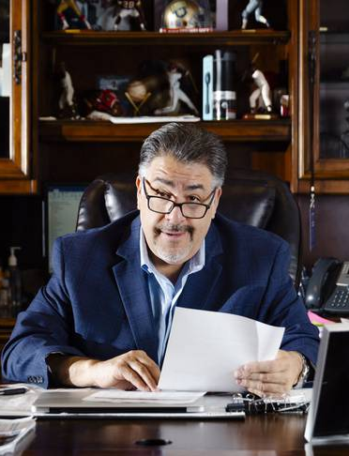
Persona 2
“Hi, I am a Healthcare Field Agent. I drive all over to help advise and get people to enroll in Healthcare options. Because of this, I need something that is simple, quick, and could use to get people enrolled quickly and drive-up sales for my company.”

Slide 4

Persona 3
“Hi, I am a part of the in-office Data Entry team. We need a better way of inputting and saving data. One that streamlines our process and allows for us to quickly finish Open Enrollment and healthcare paperwork.”

